Slide 1
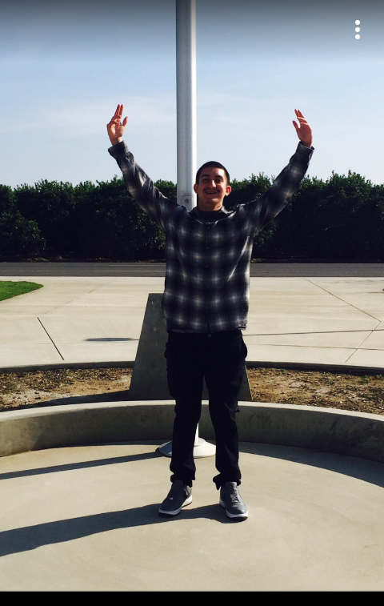
Daniel Alvarado

Slide 2
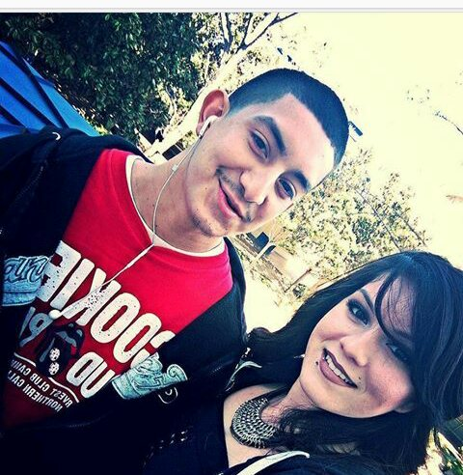
A Little About Myself
Born August 4, 2000
Birthplace in Porterville, Ca
Grew up in Lindsay, Ca
Three sisters
Enjoy listening to music
I like hanging out with friends

Slide 3
High School Experience
Struggles
Procrastination
Social Skills
Not being involved
Accomplishments
I’m graduating a year early
Capable of completing my tasks
High school has readied me for my next steps

Slide 4
Job Shadow
Independent studies teacher
Difference between regular teaching and Independent teaching
Individually work with students at certain times
Don’t see myself being a teacher
It suited my enthusiasm for helping others

Slide 5
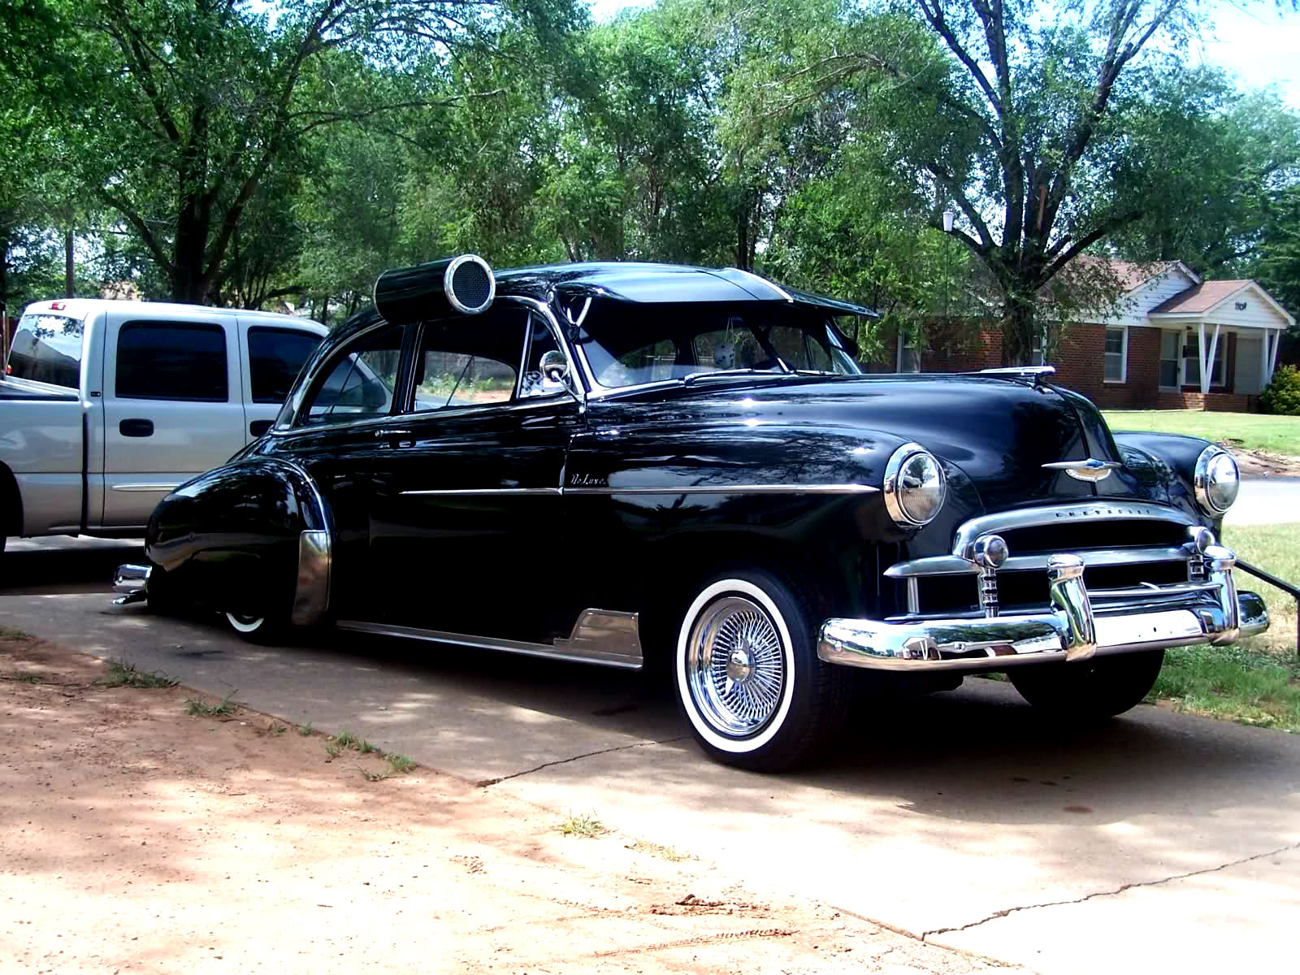
Pathway
Auto
It’s important to know
A lot of hands on work
Learned how to transfer information from books to the real world

Slide 6
Post-High School Plans
Work and attend community college
Provides experience for the future
PC for 2 years
Isn’t far from home
Transfer to a 4 year college to peruse my career

Slide 7
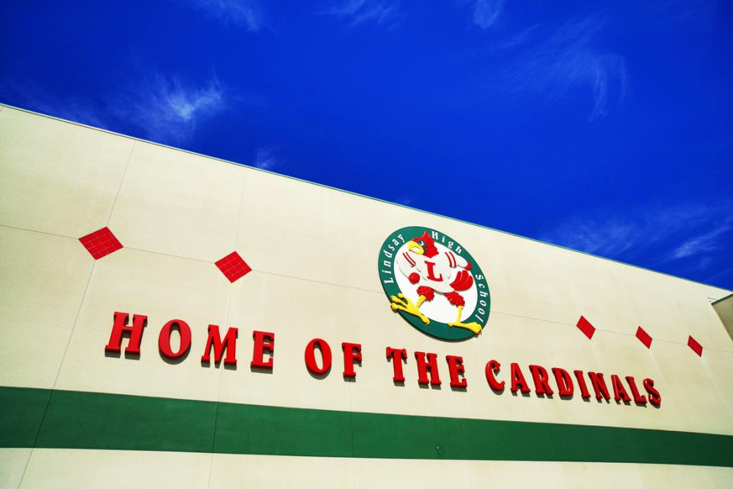
Leaving LHS
Going to miss staff and former classmates
Helped me understand the importance of education
Take learning into my own hands
Be organized
Prepared me for the future

Slide 8
Thank you! Any Questions?

